Slide 1
TONG HSING ELECTRONIC IND., LTD.
First Quarter 2023
Earnings Result
Apr 20th, 2023
©2023 Tong Hsing
TONG HSING PROPERTY
P1

Slide 2
Disclaimer
This presentation contains forward-looking statements. These forward-looking statements are subject to risks, uncertainties and assumptions, some of which are beyond our control. Actual results may differ materially from those expressed or implied by these forward-looking statements. Because of these risks, uncertainties and assumptions, the forward-looking events and circumstances discussed in this presentation might not occur in the way we expect, or at all. You should not place undue reliance on any forward-looking information.
In preparing the information herein, Tong Hsing have relied upon and assumed, without independent verification, the accuracy and completeness of all information available from public sources or which was provided to Tong Hsing or which was otherwise reviewed by Tong Hsing. Neither Tong Hsing nor its advisors have made any representation or warranty as to the accuracy or completeness of such information and nor do they assume any undertaking to supplement such information as further information becomes available or in light of changing circumstances. None of Tong Hsing, nor any of their respective affiliates, advisers or representatives shall have any liability whatsoever(in negligence or otherwise) for any loss howsoever arising from any use of this presentation or its contents or otherwise arising in connection with this presentation. Neither this presentation nor any of its contents may be reproduced to a third party without the prior written consent of Tong Hsing.

Slide 3
Table of Contents
Financial Update
Business Update
Message Take Out
©2023 Tong Hsing
TONG HSING PROPERTY

Slide 4
1Q 23 Income Statement Q/Q Comparison
*2023 Q1 Weighted Average Outstanding Shares : 160.814Million
*2022 Q4 Weighted Average Outstanding Shares : 163.301Million
TONG HSING PROPERTY
P4

Slide 5
1Q 23 Income Statement Y/Y Comparison
*2023 Q1 Weighted Average Outstanding Shares : 160.814Million
*2022 Q1 Weighted Average Outstanding Shares : 178.570Million
TONG HSING PROPERTY
P5

Slide 6
Balance Sheet Highlight –3.31.2023
TONG HSING PROPERTY
P6

Slide 7
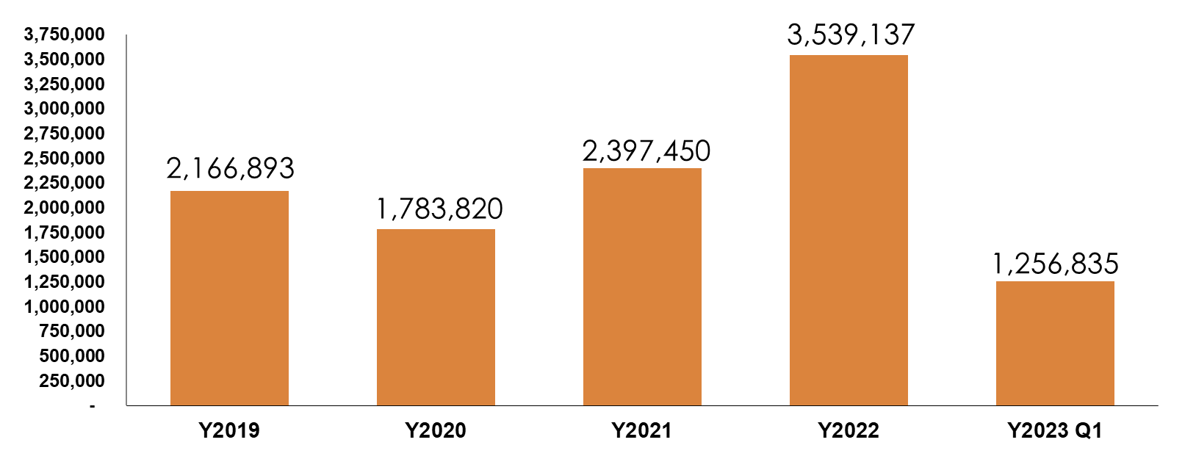
Capital Expenditure
$NTD/K

Slide 8
Table of Contents
Financial Update
Business Update
Message Take Out
©2023 Tong Hsing
TONG HSING PROPERTY

Slide 9
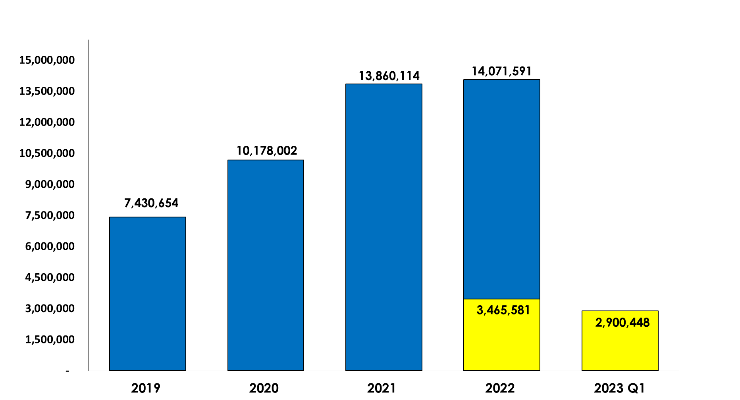
Tong Hsing Revenue History
$NTD/K
+1.5%
+36%
+37%
-16%
©2023 Tong Hsing
TONG HSING PROPERTY
P9

Slide 10
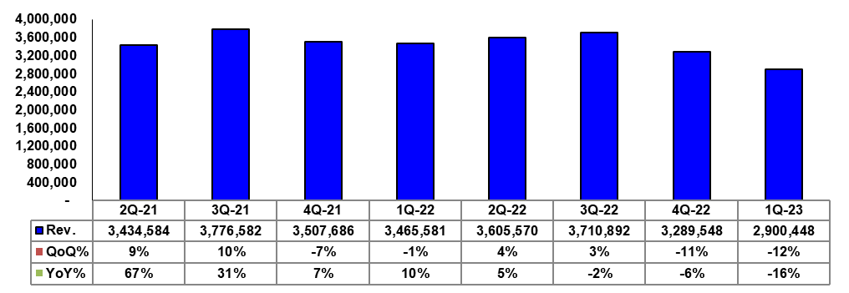
Tong Hsing Quarterly Revenue
$NTD/K
©2023 Tong Hsing
TONG HSING PROPERTY
P10

Slide 11
RF Module Quarterly Revenue Trend
$NTD/K
©2023 Tong Hsing
TONG HSING PROPERTY
P11

Slide 12
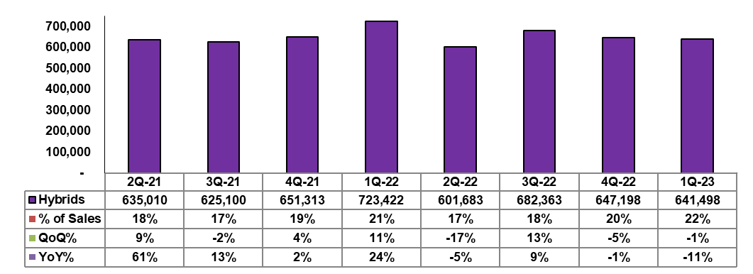
Hybrid Module Quarterly Revenue Trend
$NTD/K
©2023 Tong Hsing
TONG HSING PROPERTY
P12

Slide 13
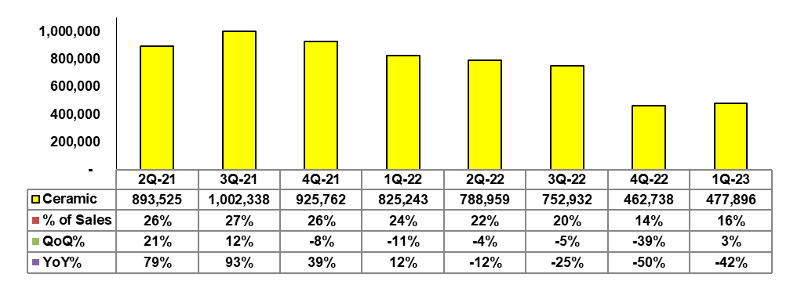
Ceramic Substrate Quarterly Revenue Trend
$NTD/K
©2023 Tong Hsing
TONG HSING PROPERTY
P13

Slide 14
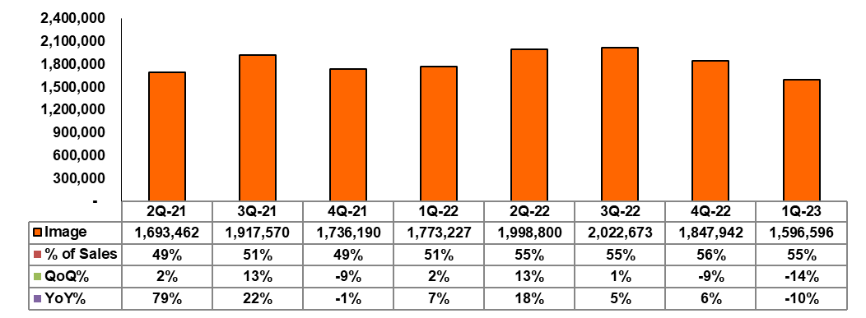
Image Product Quarterly Revenue Trend
$NTD/K
©2023 Tong Hsing
TONG HSING PROPERTY
P14

Slide 15
Table of Contents
Financial Update
Business Update
Message Take Out
©2023 Tong Hsing
TONG HSING PROPERTY

Slide 16
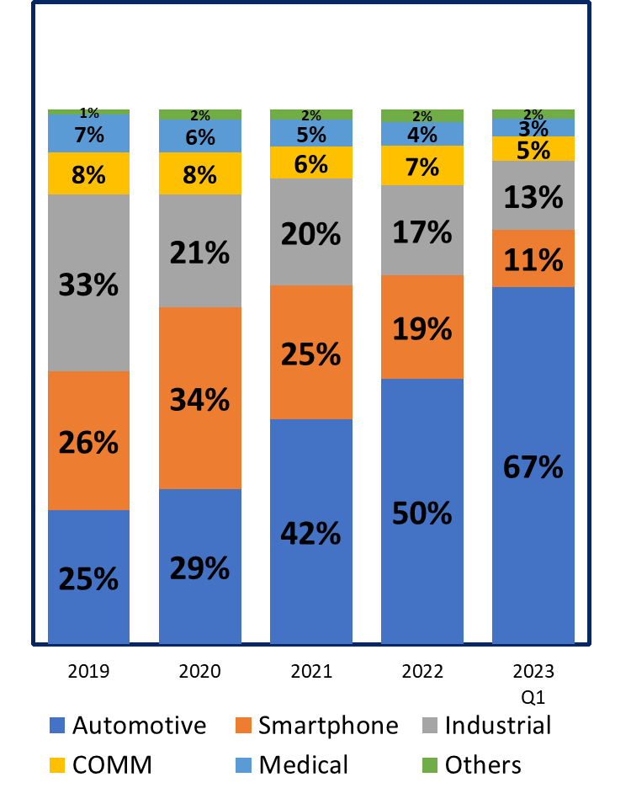
Message Take Out
Sales %
TONG HSING PROPERTY

Slide 17
Outlook
“Due to slow clearance of smartphone inventory and hiccup in the automotive CIS market, we expect the revenue of Q2 will be similar to the last quarter ”
TONG HSING PROPERTY

Slide 18
Q & A
©2023 Tong Hsing
TONG HSING PROPERTY
P18

Slide 19
Thank you for Listening!
Reality / Integrity / Customer First
Please Visit Us @ https://www.theil.com
©2023 Tong Hsing
TONG HSING PROPERTY
P19

