Slide 1

TONG HSING ELECTRONIC IND., LTD.
Second Quarter 2022
Earnings Result
Aug 12th, 2022

Slide 2
Disclaimer
This presentation contains forward-looking statements. These forward-looking statements are subject to risks, uncertainties and assumptions, some of which are beyond our control. Actual results may differ materially from those expressed or implied by these forward-looking statements. Because of these risks, uncertainties and assumptions, the forward-looking events and circumstances discussed in this presentation might not occur in the way we expect, or at all. You should not place undue reliance on any forward-looking information.
In preparing the information herein, Tong Hsing have relied upon and assumed, without independent verification, the accuracy and completeness of all information available from public sources or which was provided to Tong Hsing or which was otherwise reviewed by Tong Hsing. Neither Tong Hsing nor its advisors have made any representation or warranty as to the accuracy or completeness of such information and nor do they assume any undertaking to supplement such information as further information becomes available or in light of changing circumstances. None of Tong Hsing, nor any of their respective affiliates, advisers or representatives shall have any liability whatsoever(in negligence or otherwise) for any loss howsoever arising from any use of this presentation or its contents or otherwise arising in connection with this presentation. Neither this presentation nor any of its contents may be reproduced to a third party without the prior written consent of Tong Hsing.

Slide 3
Table of Contents
Financial Update
Business Update

Slide 4
2Q 22 Income Statement
Q/Q Comparison
*2022 Q2 Weighted Average Outstanding Shares : 178.570Million
*2022 Q1 Weighted Average Outstanding Shares : 178.570Million
© 2022 TongHsing, Ltd
TH PROPERTY

Slide 5
2Q 22 Income Statement
Y/Y Comparison
*2022 Q2 Weighted Average Outstanding Shares : 178.570Million
*2021 Q2 Weighted Average Outstanding Shares : 178.474Million
© 2022 TongHsing, Ltd
TH PROPERTY

Slide 6
2022Income Statement
First Half Comparison
*2022 H1 Weighted Average Outstanding Shares : 178.570Million
*2021 H1 Weighted Average Outstanding Shares : 178.474Million
© 2022 TongHsing, Ltd
TH PROPERTY

Slide 7
Balance Sheet Highlight –6.30.2022
© 2022 TongHsing, Ltd
TH PROPERTY

Slide 8
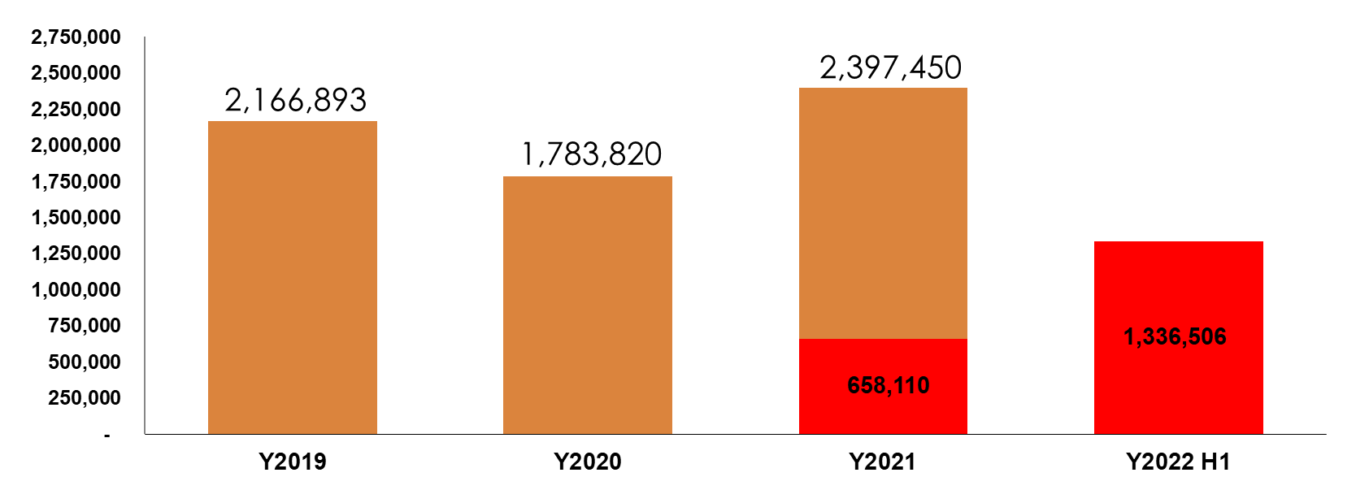
Capital Expenditure
$NTD/K
© 2022 TongHsing, Ltd
TH PROPERTY

Slide 9
Table of Contents
Financial Update
Business Update

Slide 10
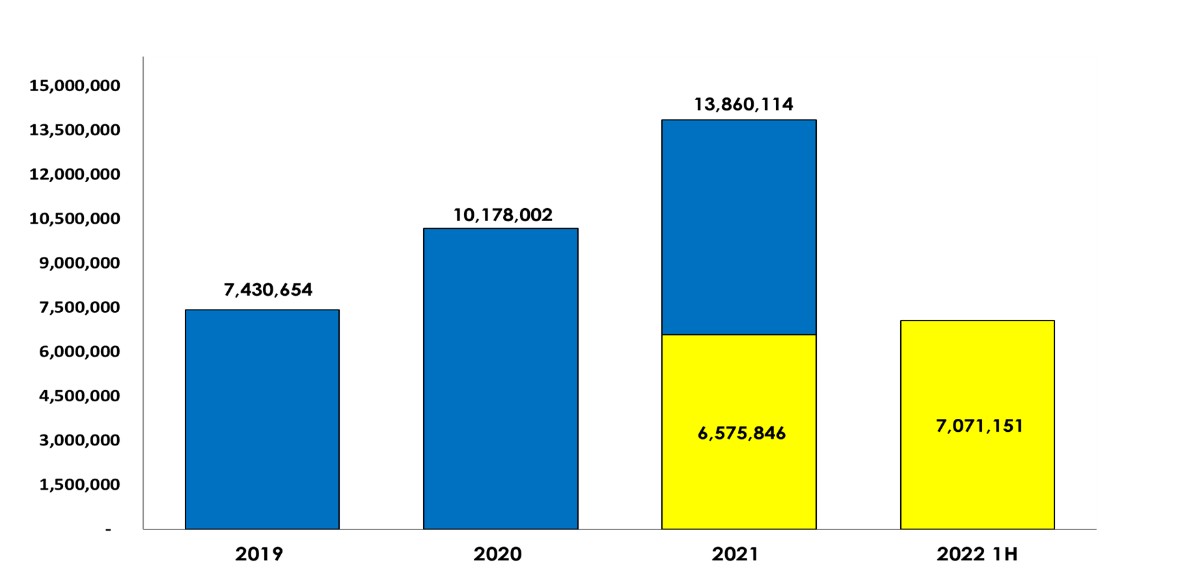
Tong Hsing Revenue History
$NTD/K
+36%
+37%
+8%
© 2022 TongHsing, Ltd
TH PROPERTY

Slide 11
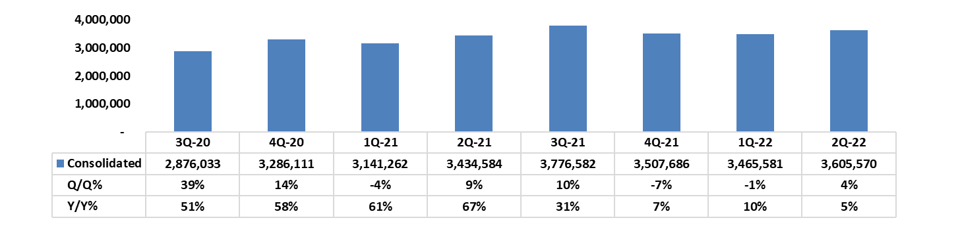
Tong Hsing Quarterly Revenue
$NTD/K
© 2022 TongHsing, Ltd
TH PROPERTY

Slide 12

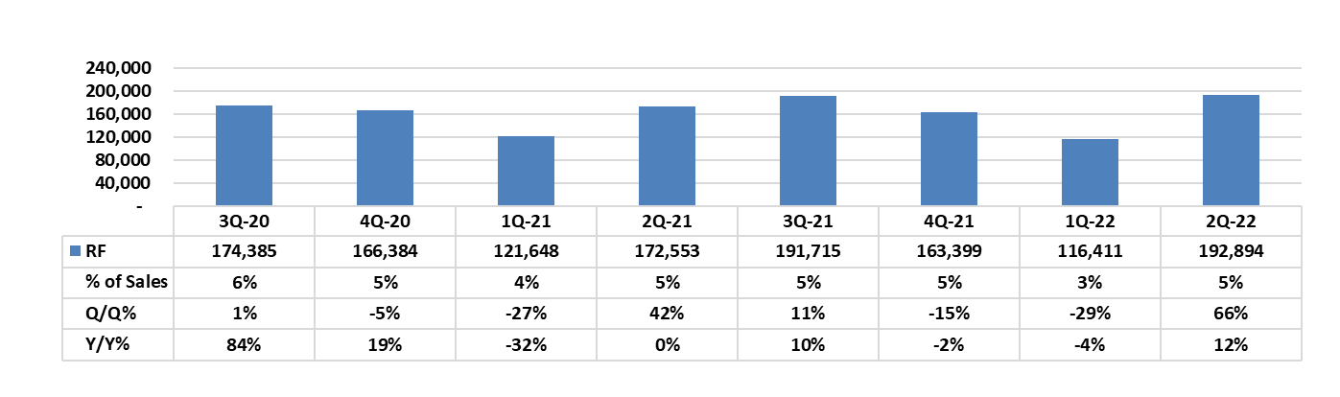
RF Module
Quarterly Revenue Trend
$NTD/K
© 2022 TongHsing, Ltd
TH PROPERTY

Slide 13

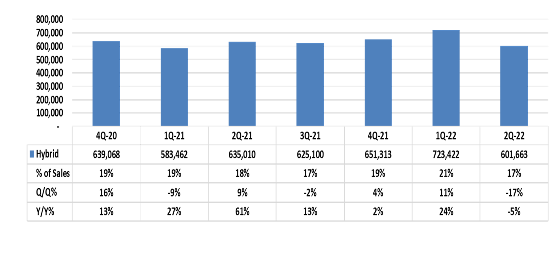
Hybrid Modules & Specialty Packaging
Quarterly Revenue Trend
$NTD/K
© 2022 TongHsing, Ltd
TH PROPERTY

Slide 14

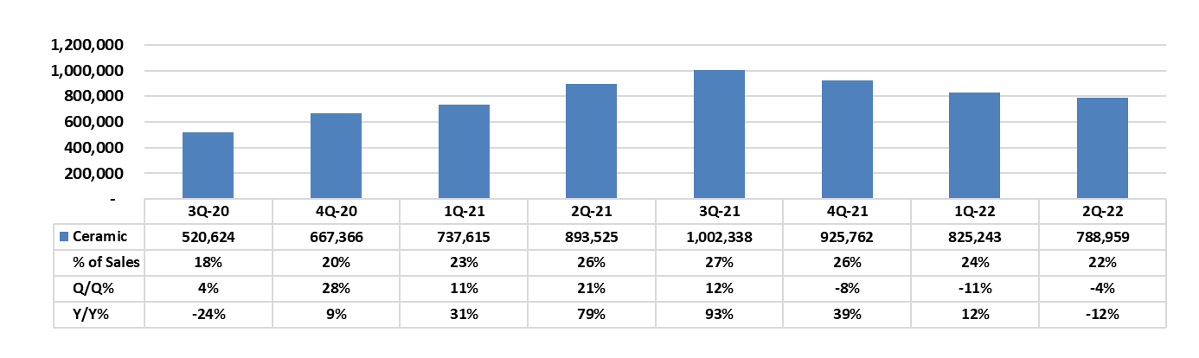
Ceramic Metallized Substrate
Quarterly Revenue Trend
$NTD/K
© 2022 TongHsing, Ltd
TH PROPERTY

Slide 15


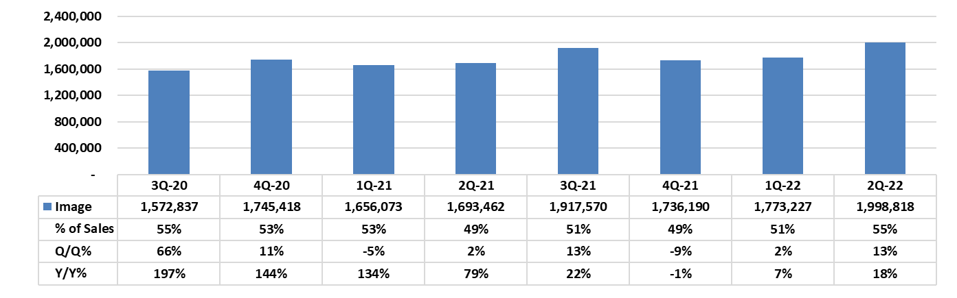
Image Products
Quarterly Revenue Trend
$NTD/K
© 2022 TongHsing, Ltd
TH PROPERTY

Slide 16
www.theil.com

