Slide 1
Tong Hsing
First Quarter 2022
Earnings Conference
Apr 27th, 2022

Slide 2
Disclaimer
This presentation contains forward-looking statements. These forward-looking statements are subject to risks, uncertainties and assumptions, some of which are beyond our control. Actual results may differ materially from those expressed or implied by these forward-looking statements. Because of these risks, uncertainties and assumptions, the forward-looking events and circumstances discussed in this presentation might not occur in the way we expect, or at all. You should not place undue reliance on any forward-looking information.
In preparing the information herein, Tong Hsing have relied upon and assumed, without independent verification, the accuracy and completeness of all information available from public sources or which was provided to Tong Hsing or which was otherwise reviewed by Tong Hsing. Neither Tong Hsing nor its advisors have made any representation or warranty as to the accuracy or completeness of such information and nor do they assume any undertaking to supplement such information as further information becomes available or in light of changing circumstances. None of Tong Hsing, nor any of their respective affiliates, advisers or representatives shall have any liability whatsoever(in negligence or otherwise) for any loss howsoever arising from any use of this presentation or its contents or otherwise arising in connection with this presentation. Neither this presentation nor any of its contents may be reproduced to a third party without the prior written consent of Tong Hsing.

Slide 3
Table of Contents
Financial Update
Business Update

Slide 4
1Q 22 Income Statement
QoQ Comparison
- consolidated
*2022 Q1 Weighted Average Outstanding Shares : 178.570Million
*2021 Q4 Weighted Average Outstanding Shares : 178.538Million

Slide 5
1Q 22 Income Statement
YoY Comparison
- consolidated
*2022 Q1 Weighted Average Outstanding Shares : 178.570Million
*2021 Q1 Weighted Average Outstanding Shares : 178.474Million

Slide 6
1Q 22 Operating Results Summary
- consolidated

Slide 7
Balance Sheet Highlight –3.31.2022
- consolidated

Slide 8
Table of Contents
Financial Update
Business Update

Slide 9
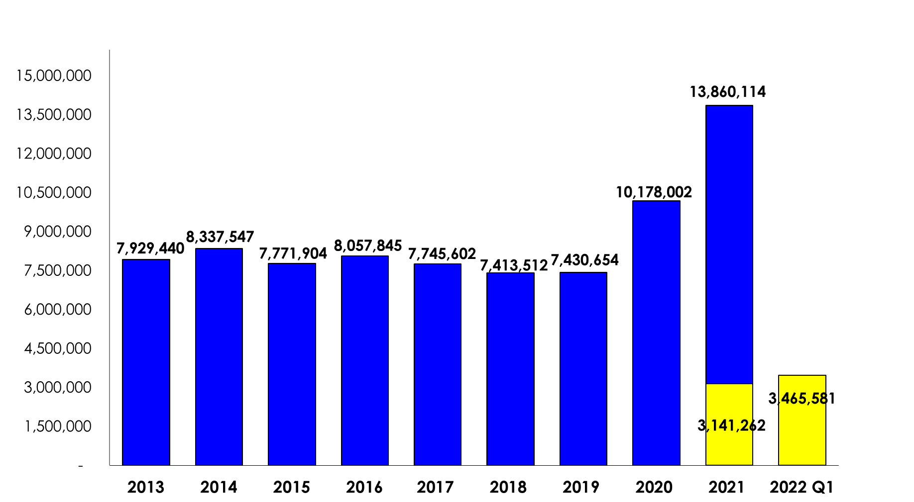
Tong Hsing Revenue History
- consolidated
(Unit: K_NTD)
+36%
+5%
-7%
+4%
-4%
-4%
+37%
+0%
+10%

Slide 10
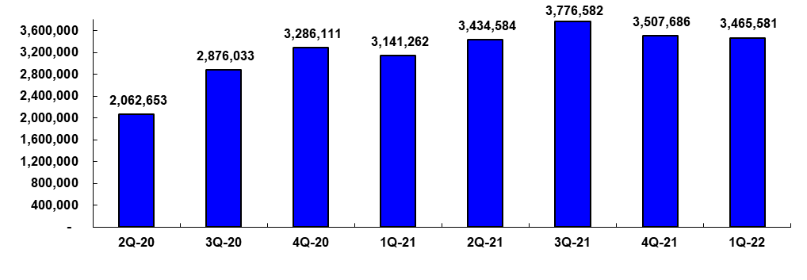
Tong Hsing Quarterly Revenue
- consolidated
Unit:K_NTD
+10%
-7%
-1%
-4%
+9%
+14%
+39%
YoY%
+13%
+51%
+58%
+61%
+67%
+31%
+7%
+10%

Slide 11
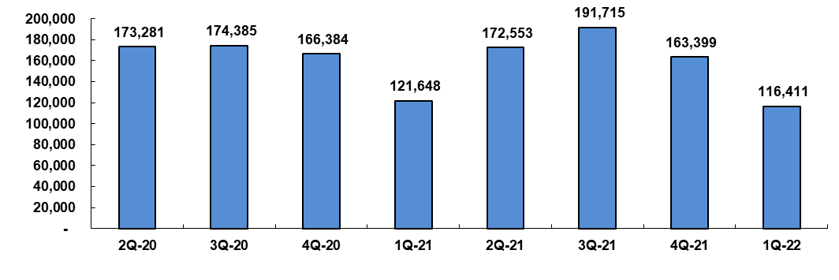
RF Module
Quarterly Revenue Trend
- consolidated
Unit:K_NTD
+11%
-15%
+1%
-5%
-27%
+42%
-29%
YoY%
+105%
+84%
+19%
-32%
+0%
+10%
-2%
-4%

Slide 12
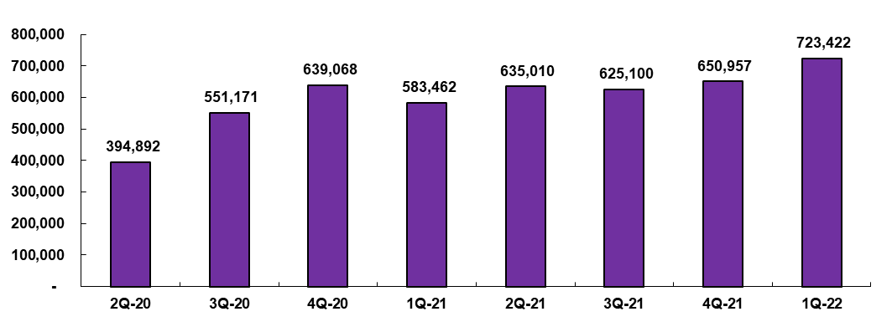
Hybrid Modules & Specialty Packaging
Quarterly Revenue Trend
- consolidated
Unit:K_NTD
+11%
-2%
+4%
+16%
-9%
+9%
+40%
YoY%
-21%
+2%
+13%
+27%
+61%
+13%
+2%
+24%

Slide 13
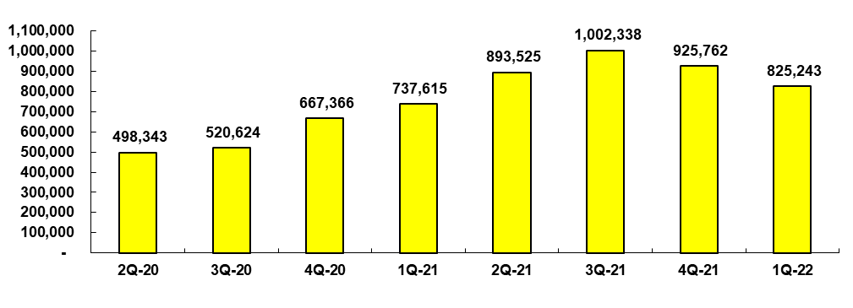
Ceramic Metallized Substrate
Quarterly Revenue Trend
Unit:K_NTD
- consolidated
+12%
-8%
-11%
+21%
+11%
+28%
+4%
YoY%
-27%
-24%
+9%
+31%
+79%
+93%
+39%
+12%

Slide 14
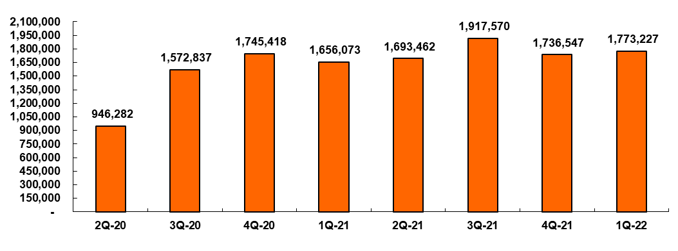
Image Products
Quarterly Revenue Trend
- consolidated
Unit:K_NTD
+13%
-9%
-5%
+2%
+2%
+11%
+66%
YoY%
+84%
+197%
+144%
+134%
+79%
+22%
-1%
+7%

Slide 15
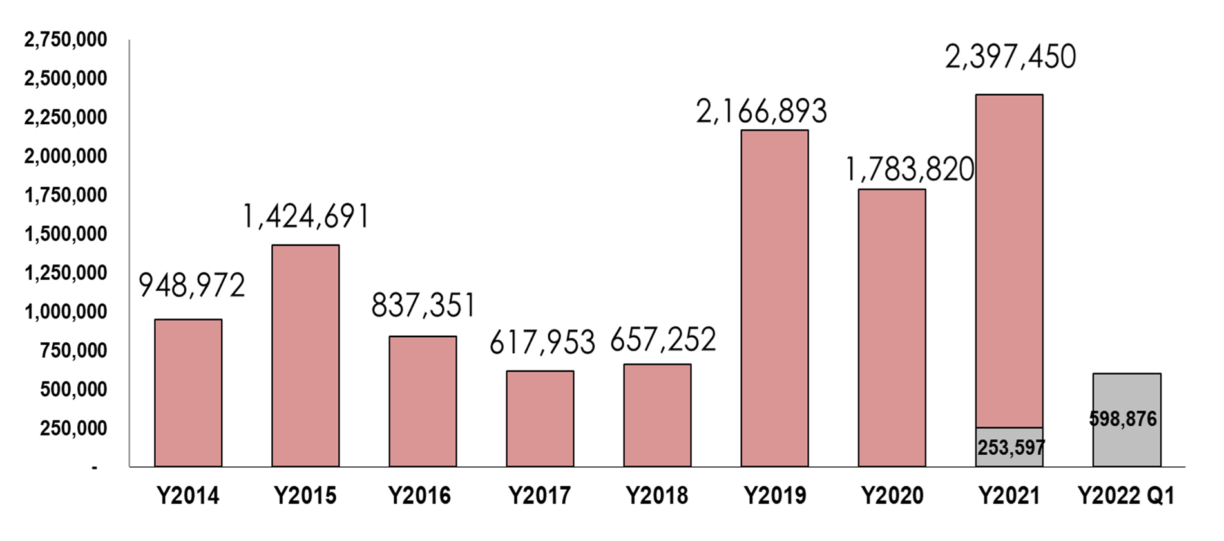
Capital Expenditure
Unit:K_NTD
- consolidated
-38%
+34%
+230%
+50%
-41%
-26%
+6%
+136%

Slide 16
http://www.theil.com

